Slide 1
ORM

Slide 2
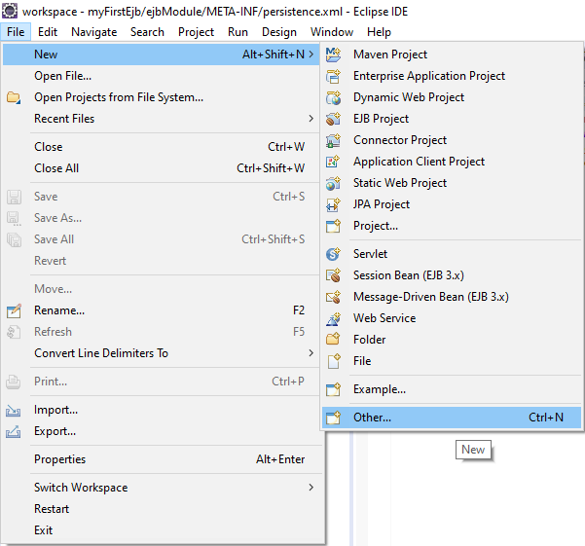
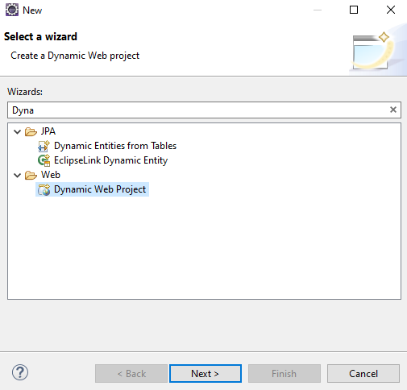
How to create a Dynamic Web Project
Go to File -> New -> Others… -> Dynamic Web project

Slide 3
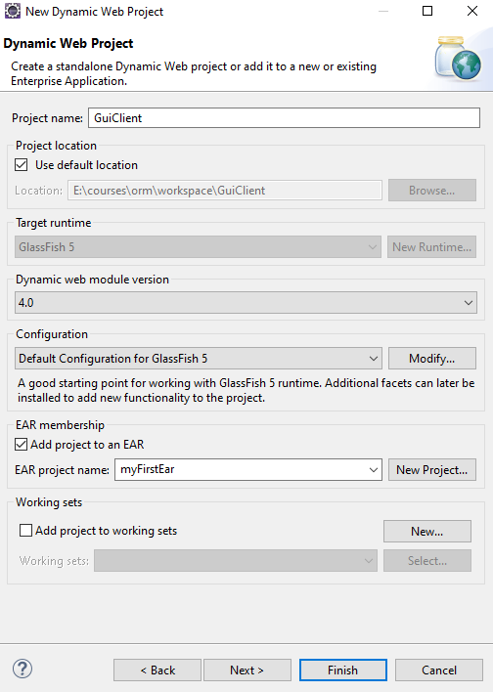
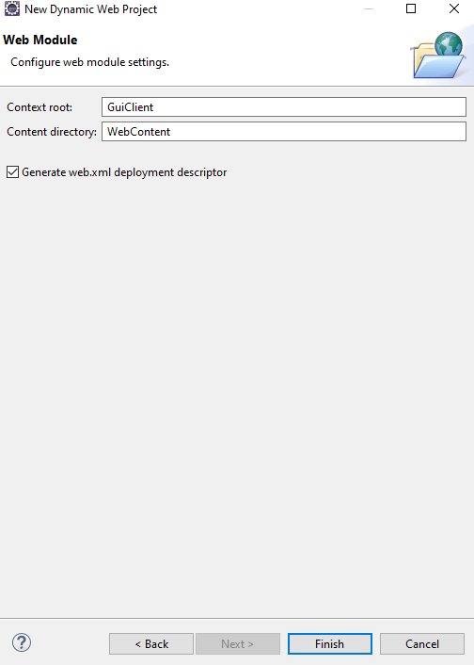
How to create a Dynamic Web Project
Add a project name, chose for Target runtime – Glassfish5, check Add project to an EAR, click on Next button. In the end chose “Generate web.xml …”

Slide 4
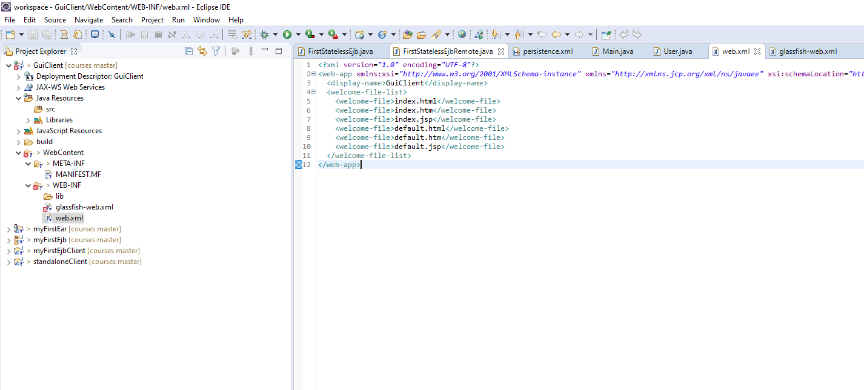
How to create a Dynamic Web Project
Go to WEB-INF/web.xml

Slide 5
How to create a Dynamic Web Project
Change the content of the web.xml with this one.
In case that your xhtml file will be not displayed change the url pattern like this:

Slide 6
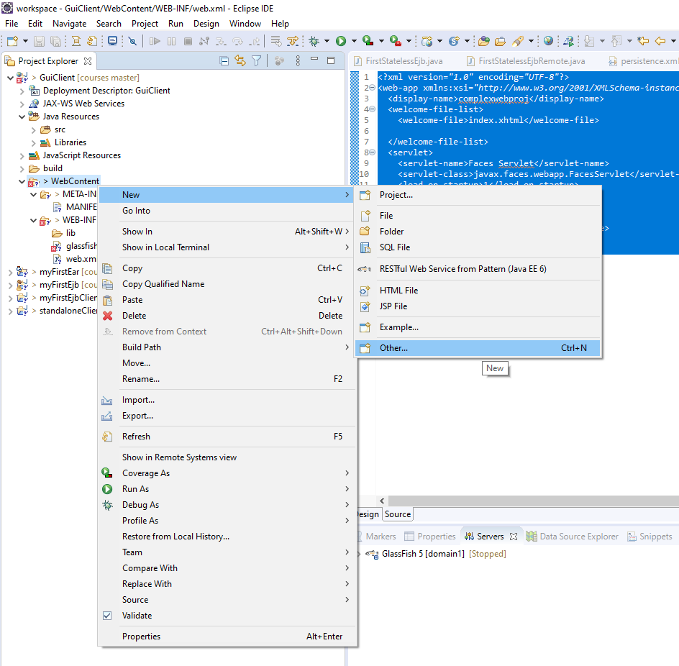
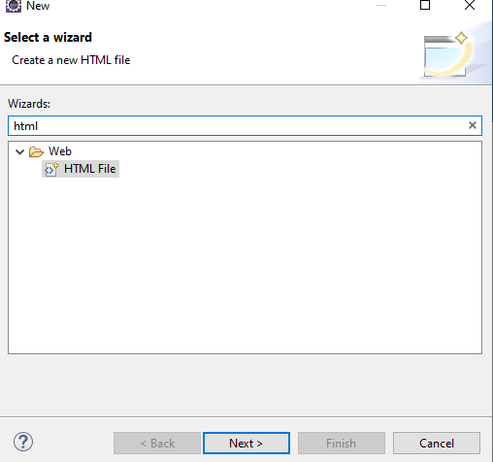
How to create a Dynamic Web Project
In order to create a xhtml file go to New->Others…->HTML File

Slide 7
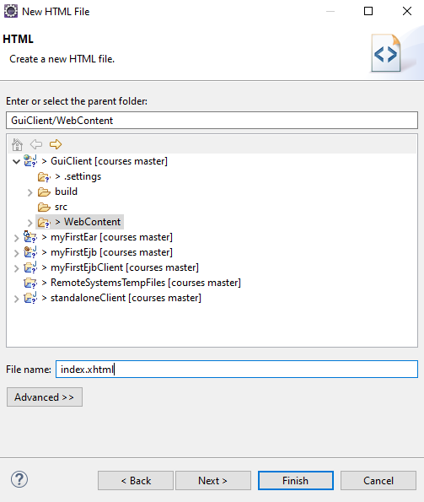
How to create a Dynamic Web Project
Add xhtml as file extension

Slide 8
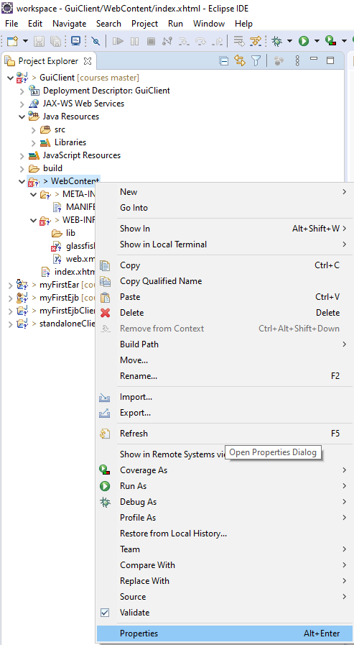
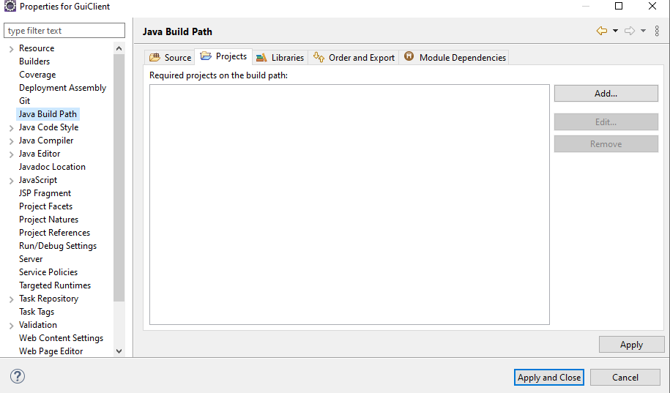
How to create a Dynamic Web Project
In order to add ejbClient as dependency right click on the Project -> Properties -> Java Build Path -> Projects -> Add..

Slide 9
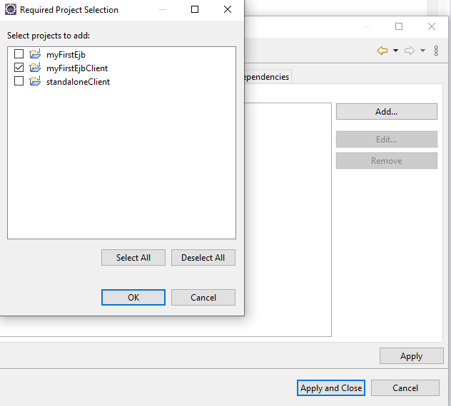
How to create a Dynamic Web Project
Check you ejb client project, then click on OK button, click on Apply, click on Apply and Close.

Slide 10
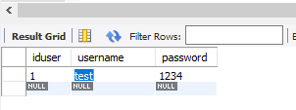
How to create a Dynamic Web Project
You can take a look in the example project in order to see a possible architecture for the application. The database that was used(testdb) contains only one table named “User” and it looks like this:

